Slide 1
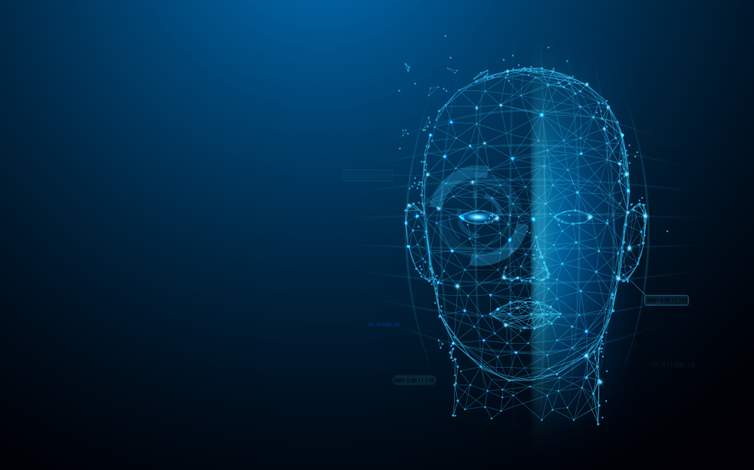
Human Face Recognition Attendance System
BY
SURYANSH GUPTA

Slide 2
IntroDuction
As I AM making a system which can recognize face and match with its own database. It will make the attendance system more authentic. Our primary goal is to help the lecturers, improve and organize the process of track and manage student attendance and absenteeism.

Slide 3
What Is Face Detection?
Face detection is a type of computer vision technology that is able to identify people’s faces within digital images. This is very easy for humans, but computers need precise instructions. The images might contain many objects that aren’t human faces, like buildings, cars, animals, and so on.

Slide 4
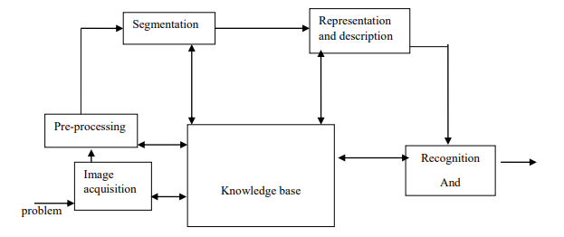
Plan of works

Slide 5
Advantages
The system stores the faces that are detected and automatically marks attendance.
Ease of use is manipulate and recognize the faces in real time using. Multiple face detection. Multipurpose software Can be used in different places.

Slide 6
DisAdvantages
The accuracy of the system is not 100%. It can only detect face from a limited distance.

Slide 7
What Are Features?
A feature is a piece of information in an image that is relevant to solving a certain problem. It could be something as simple as a single pixel value, or more complex like edges, corners, and shapes. You can combine multiple simple features into a complex feature.
Applying certain operations to an image produces information that could be considered features as well. Computer vision and image processing have a large collection of useful features and feature extracting operations.
Basically, any inherent or derived property of an image could be used as a feature to solve tasks.

Slide 8
Result Analysis
In my project I have been working more the 2000 pictures. The result of project percentages is almost 85-90%. Though it is not enough for this little dataset. To make almost 98% accuracy we need to use more powerful hardware and also need more resources.

Slide 9
Why we don’t use Neural Network.
Raspberry Pi isn’t powerful enough to compute the images using neural or deep learning.
The problem are:
not enough ram
Processor is slow
not the right hardware for heavy computational processes

Slide 10
Future works
In future, I am going to make the project online. So that this project can be use in bigger area like University, work place , factory etc. And also add the neural network or deep learning. If we use the neural network we can have more accuracy around 99.9% with big datasets.

Slide 11
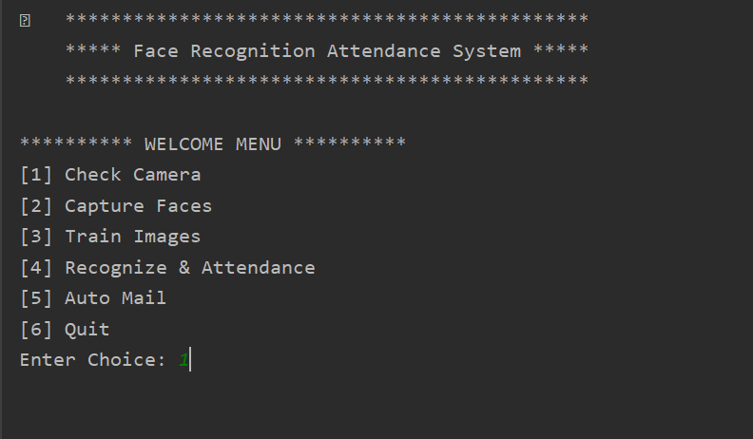
FRAS Interface

Slide 12
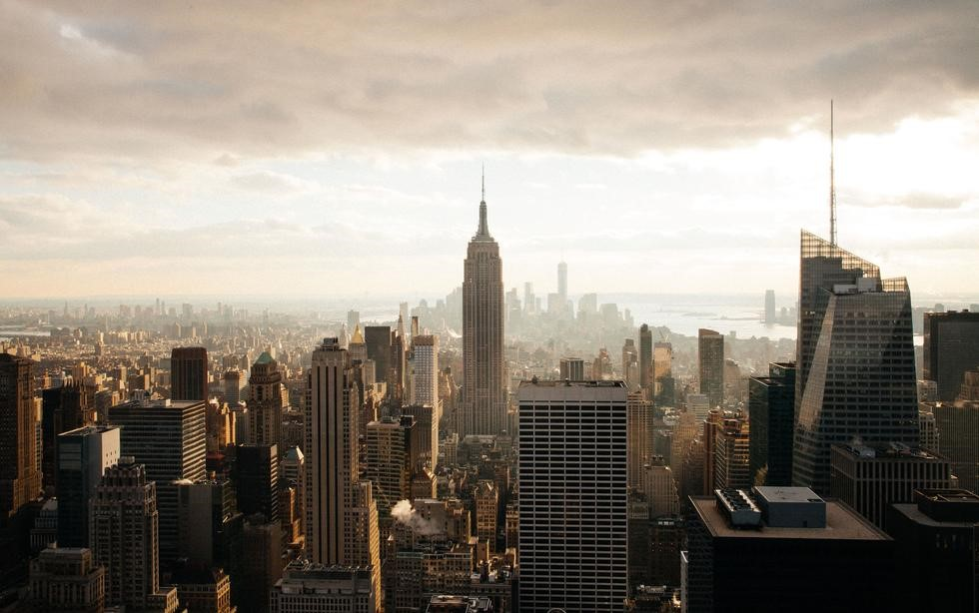






Milestone & TIME FRAME
100%
100%
100%
100%
100%
E
Installing
Products
Image Processing
& apply
Write System
code
Use camera for Image
Processing
Assembling Everything

